Slide 1
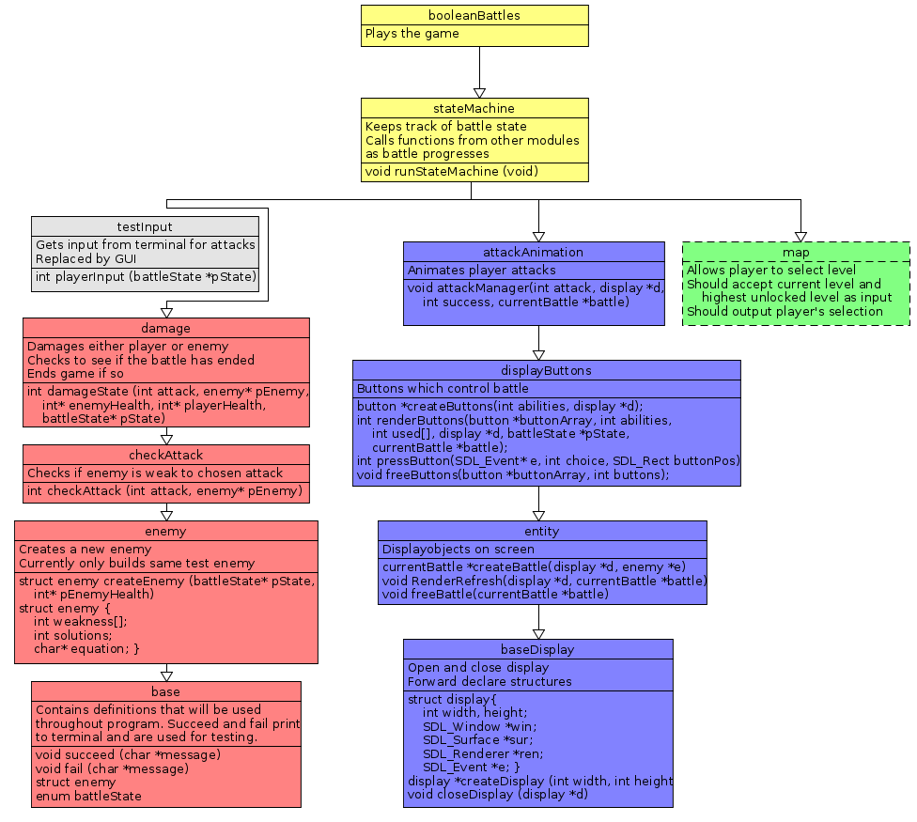
Module Diagram
Tree split into three distinct branches that could be worked on independently
Each module designed to be tested independently of modules above it
testInput module used to test Logic branch with out GUI interface from Display branch
Display branch was one module originally, but was split up for testing and flexibility

Slide 2
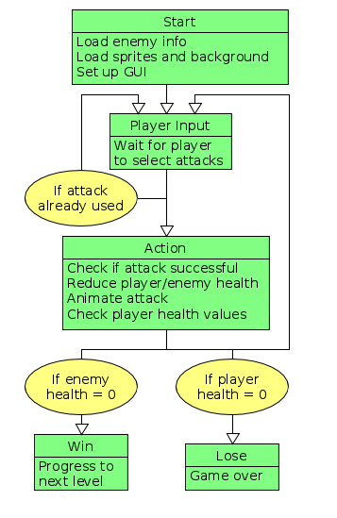
State Machine
State machine to govern game mechanics
Majority of functions split between Player Input and Action
Originally included an enemy turn as well, but was removed to make game simpler, more enjoyable and more focussed on boolean logic

